Slide 1



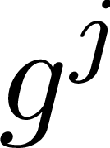
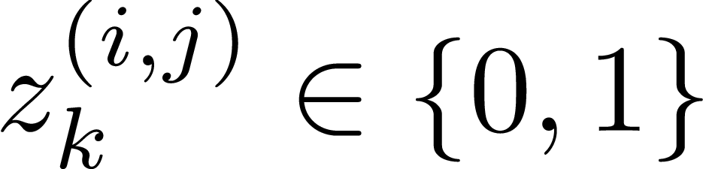
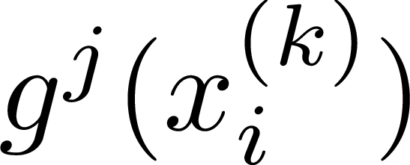
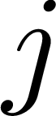
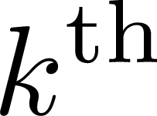
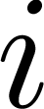
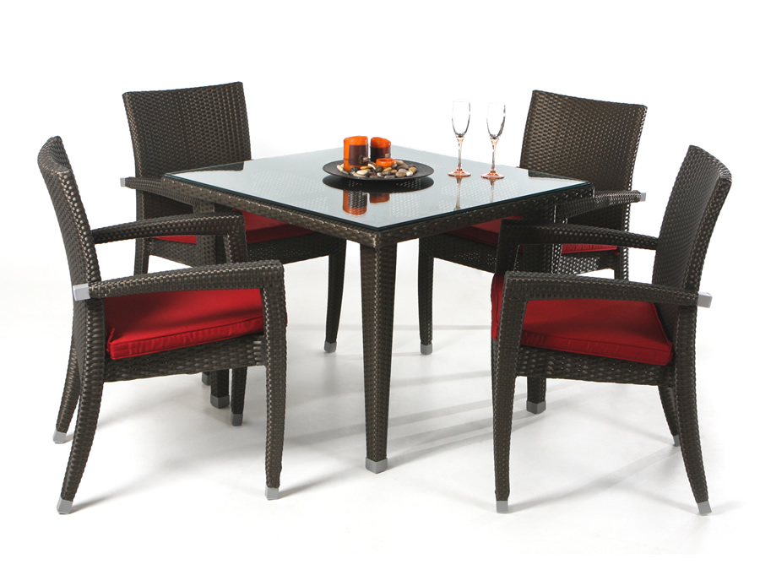

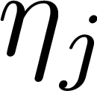
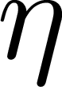

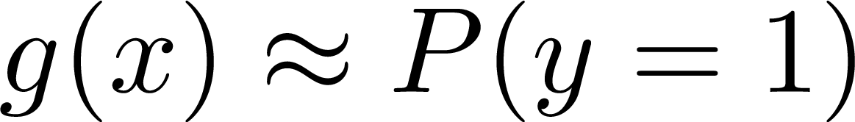
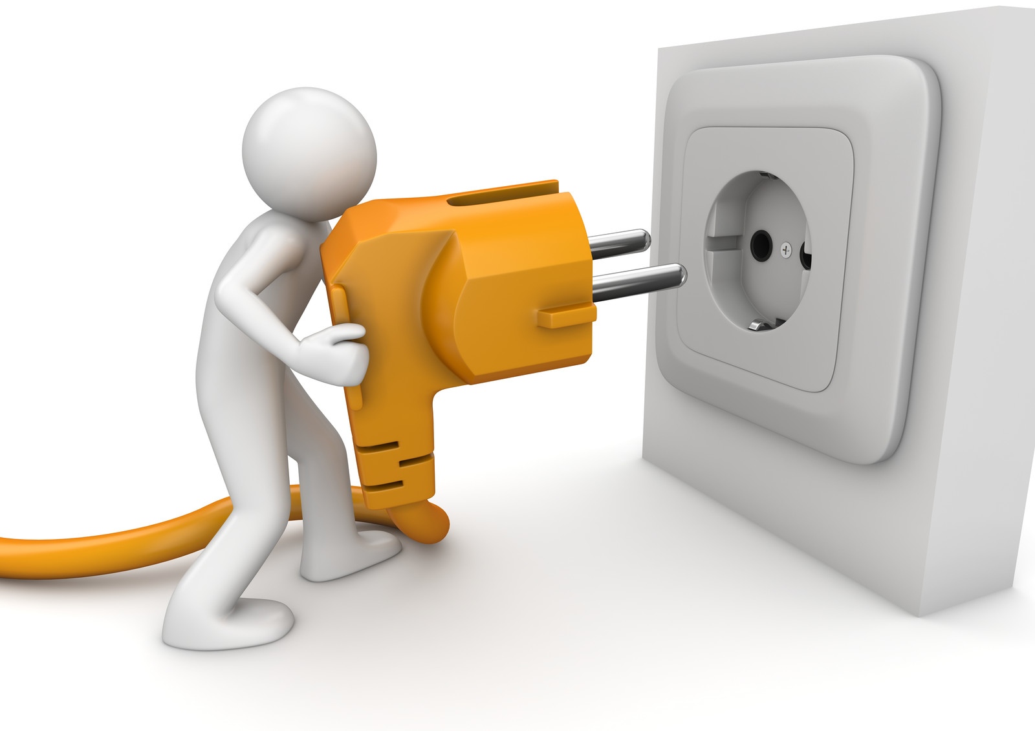
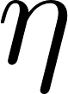

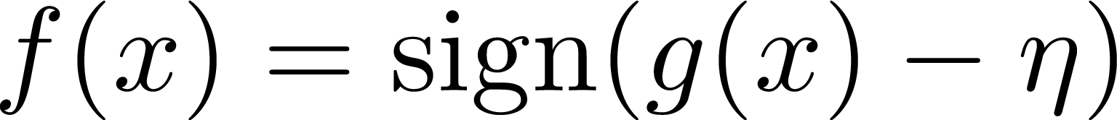




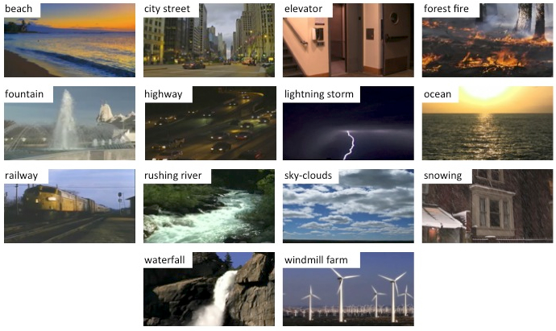
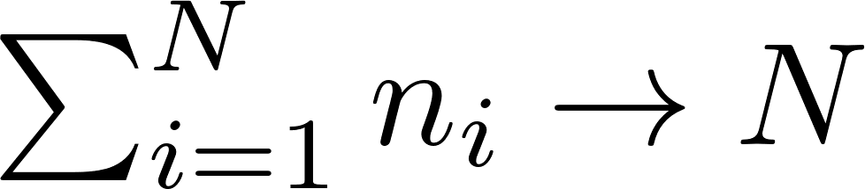
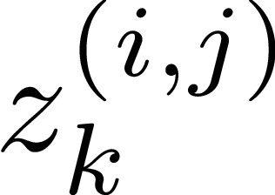
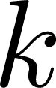
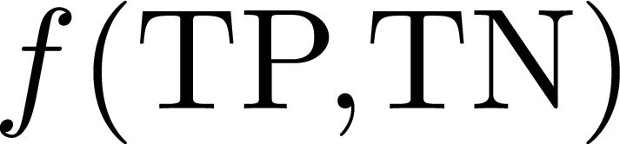
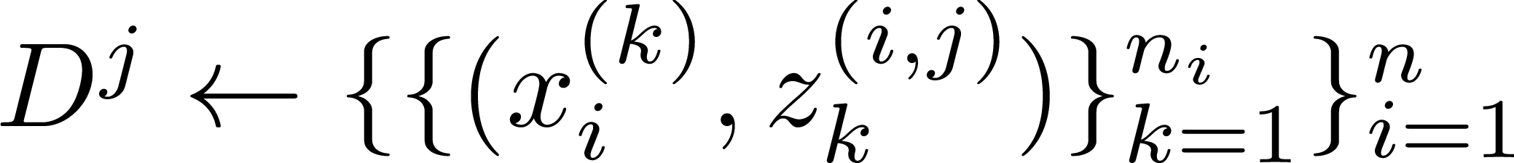
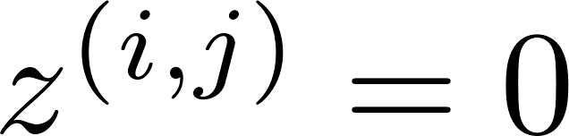
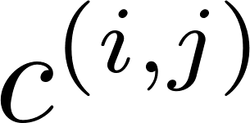
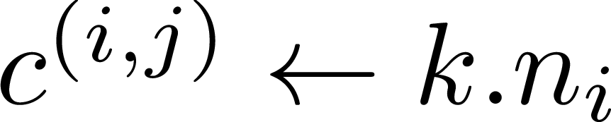
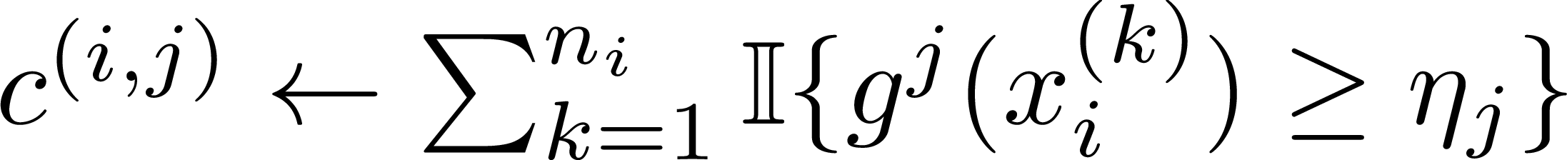
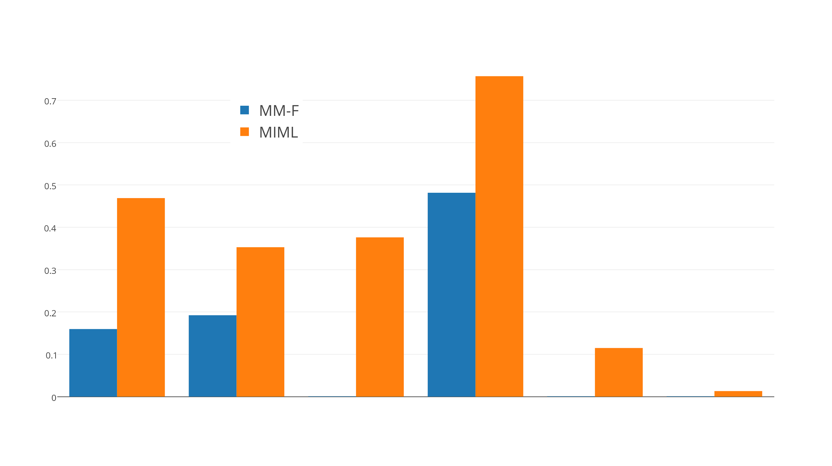
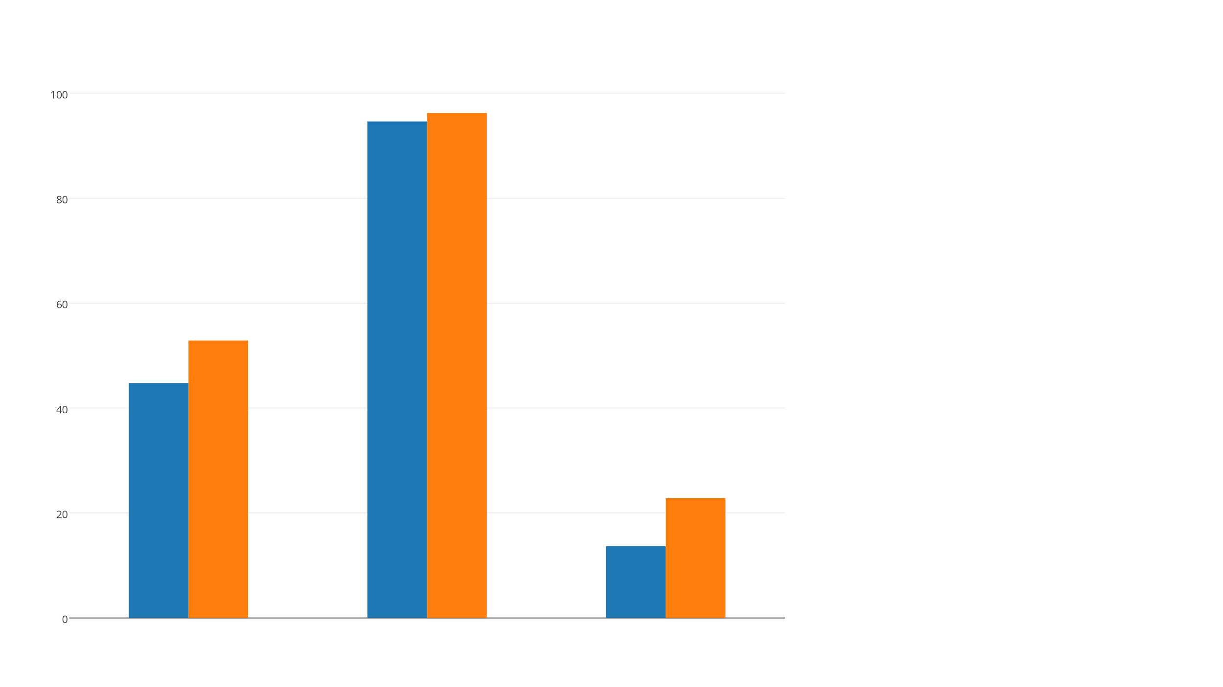
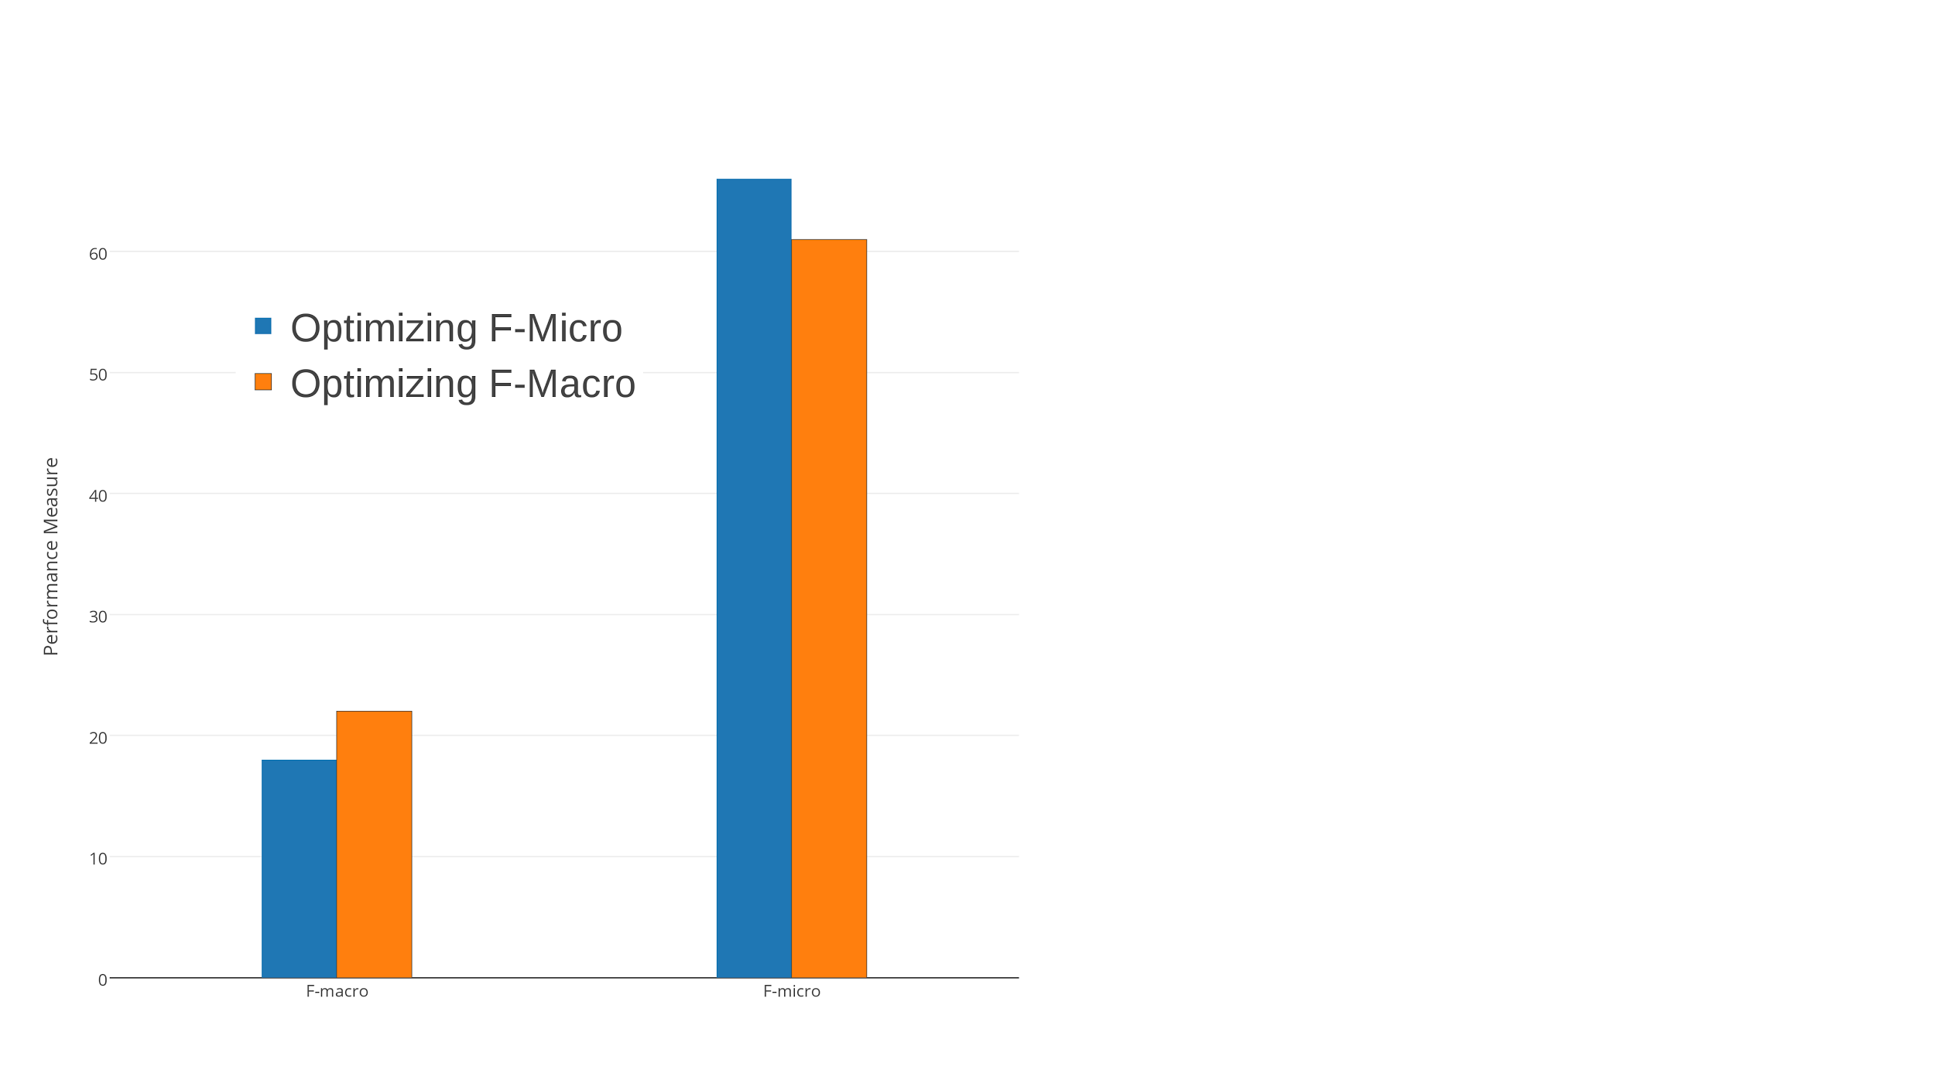
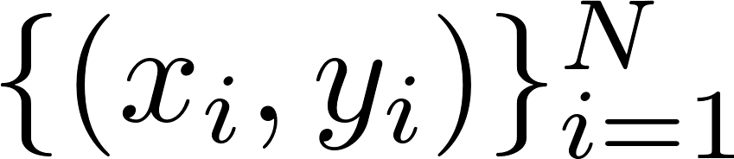
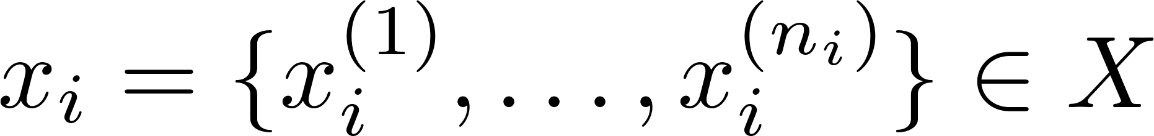


Scalable Optimization of Multivariate Performance Measures
in Multi-instance Multi-label Learning
Apoorv Aggarwal*, Sandip Ghoshal*, Ankith M S*, Suhit Sinha*, Ganesh Ramakrishnan*, Purushottam Kar#, Prateek Jain†
*Indian Institute of Technology Bombay, INDIA
#Indian Institute of Technology Kanpur, INDIA
†Microsoft Research, INDIA
Goal: Scalable algorithm for optimizing multivariate performance measures for multi-instance multi-label (MIML) learning problems
MIML_perf: A Novel Plugin Classifier Learning Framework
CPE-Train
Treat hidden variables as instance level labels
Train a CPE classifier for each label
Use to model probability that the instance in bag expresses label
Multi Instance Multi Label Learning
Drawbacks of Existing Approaches
Training Data: Every object in the scene is not labeled. Only objects present in the scene are provided
Training Objective ≠ Evaluation Measure
Not scalable to large, web scale datasets
Ill suited for label imbalance problems
Tuning the Thresholds [EUM Approach]
{Chair, Table}
U
Optimizing F-macro → threshold for label
Optimizing F-micro → Single threshold
I₁
I₂
I₃
(Instance Level) (Bag Level, label j) (Maximize Performance Measure)
{Chair, Table, Bed}
Plug-in Classifiers
Aggregation
Find Threshold
Threshold
Learn a CPE model to predict
Tune a threshold to obtain a classifier
to maximize perf.
measure , e.g. classfn accuracy, F-measure
Challenge: lack of instance level training
in MIML. Learning CPE model itself a challenge
DISTANT SUPERVISION
Knowledge Base + Corpus
Speed up while tuning the thresholds
No. of CPE Scores = No. of instances →
Tune the threshold over the largest
CPE Scores in the bags only
F-scores can be written as
Sort the CPEs and do a linear scan to find the best threshold
<Sundar Picchai , Google>
CeoOf , EmployeeOf
Feature Vector(“ Sundar Pichai joined Google in 2004 ”)
Feature Vector(“ Sundar Pichai is the new CEO of Google ”) .
Millions
Image Classification
Relation Extraction
Monotonicity
property
Sundar Pichai is now the CEO of Google
Sundar Pichai employed by Google in 2004
Sundar Pichai led many products of Google
Solution: EM-style alternating approach
Model instance level labels using latent variables
models if instance in bag expresses label or not
Alternately, improve latent variable assign and model
(no. of instances) (no. of bags)
(Sundar Pichai, Google)
EmployeeOf
CeoOf
Instances
Entity Pair
Relations
Fix hidden variables, update CPE models
CPE-train ( )
Performance Measures
MIML_perf
Estimating the Hidden Variables
Univariate or Decomposable Measures:
Ill suited in the presence of label imbalance or a heavy tailed label distribution. Tend to neglect performance on rare labels
Multivariate Performance Measures:
Typically non-decomposable as their evaluation does not decompose over individual points
Some performance measures such as F-macro force predictor to do well on rare labels as well.
Tune threshold(s) s.t. is maximized (EUM)
If bag does not have label → (extreme sparsity)
If bag has label , choose instances probabilistically according to CPE scores and make them 1
Choice of
Initialization –
Subsequently –
Fix plug-in models, update hidden variables
Re-estimate hidden labels probabilistically according to CPE-train scores
Experiments
MIML_{perf} (0.962)
Non Decomposable Loss Functions
M3MIML(0.946)
Dataset:
0.68
MIML_{perf} (0.5287)
Macro F-measure:
Class-wise F-measure
Averaged over all classes
Micro F-measure:
MM-F_{β}
MIML-SVM (0.4475)
Performance Measure
MIML_{perf}
Performance Measure
MIML_{perf} (0.2283)
0.46
0.48
MM-F_{β} (0.1366)
Performance Measure (Classwise F-score)
0.31
0.37
F-Macro
F-Micro
Do well on rare labels
0.19
Effect of the training objective on
test performance on the Riedel dataset
0.15
0.10
F-Micro
Scene Dataset
Avg. Precision
Reuters Dataset
F-Macro
Riedel Dataset
12.36%
4.04%
0.0
0.0
0.0
0.01
1.26%
1.09%
0.07%
0.15%
MM-F_{β}
MIML^{perf}
145 Times Faster
% of occurrence of relation classes in Riedel Dataset

